Slide 1


Self Serve Portal for Reports Generation
Details and Workflow
23.10.2017

Slide 2
The Brief
Objective :
The Self Serve Portal will be a Reports Repository that subscriber can access as per their requirements. It will have the following functions
Reports library
Instant Reports as per pre-defined Filter Definitions
Report Delivery upon payment (online)
RMG will develop API Access to Data

Slide 3
Dashboard Features
Automated Dashboard with Data Integration (API)
Data Manipulation : Clean-up, Grouping and Analysis before dashboard stage
Instant Reports Delivery by email in pdf format
Sample Reports for user to preview before ordering
User Management Module for Admin
User registration and approvals
Storing User Data
Email integrations - User registrations, Reports Delivery
Handling Custom Reports Requirements
Online Access (Cloud Hosting of the Application)
Online Payment Mechanism as per Rate Card - for login members as well as Guest

Slide 4
Sections
Login Screen
1. User Logins as per credentials given by the SSP
2. Can directly buy reports (login not mandatory)
Payment Screen
Reports Screen
1. Details of Reports Offered
2. Filters for Data Segmentation
3. Preview and Report Confirmation
1. Payment of Selected Report
2. Report Delivery Confirmation
USER
User Details
1. Users Database
2. Email Alerts
API for Accessing Data
Rate Card and E-Payment
1. Modular Rate Card (Frequency and Usage)
2. E-Payment link with Reports and Rate Card
Will be on Real Time Basis (as per User Requirement)
ADMIN

Slide 5
Solution screens

Slide 6
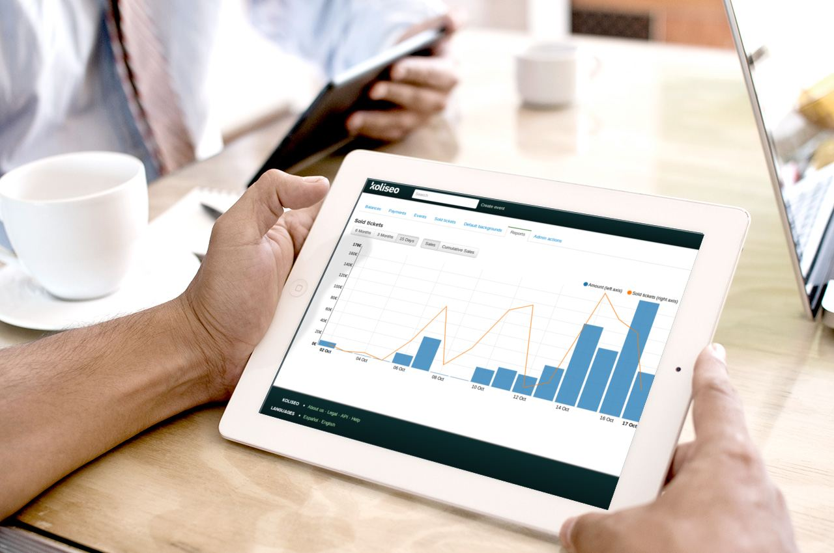

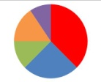
Login / Register
Email I +91981000000
Online Store
Welcome to the Online Store !
3 Easy Steps :
Browse Our Sample Reports Catalogue
Login
Pay and Use Report
Get access to multiple reports to get information on TV Viewership
BARC now offers you the flexibility to create your own reports and get them delivered to your inbox instantly!
Our Reports are Simple, Comprehensive and easy to use. You can pay for them as a one time user or do a repeat purchase for regular updates
Not a User? Register Here
Browse through the BARC Reports Catalogue here

Slide 7



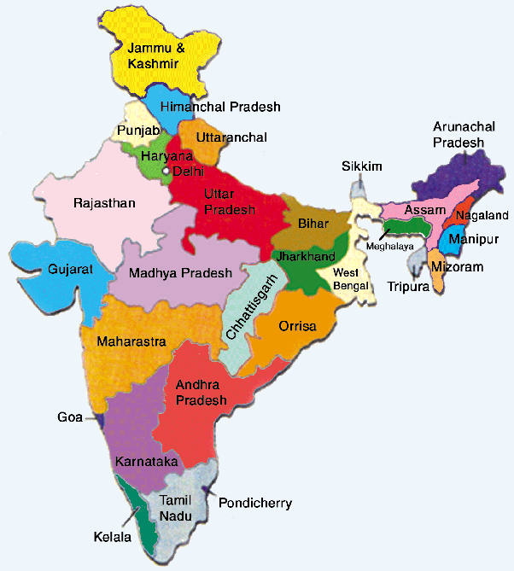
Login / Register
Email I +91981000000
Online Store
View Our Sample Reports
Top Programmes
Time Slot Analysis
TG Performance
Market Performance
Top Programmes by Type
Cross Genre Performance
Programme Trend – weekly
Programme Trend – Monthly
By Channel
By Genre
Trends by Weeks
Trends by Months
By TGs
By Genre
Trends by Weeks
Trends by Months
By Markets
By Genre
Trends by Weeks
Trends by Months
Preview
Preview
Preview
Preview
Contact us for Custom Report Generation

Slide 8
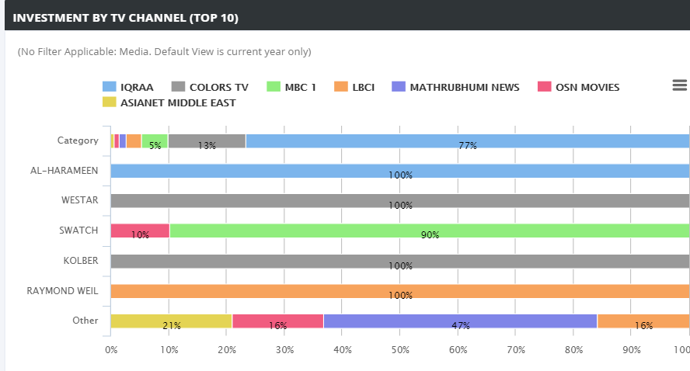
Login / Register
Email I +91981000000
Online Store
View Our Sample Reports
Top Programme by Type
Description
Top Programmes
Buy
Top Programmes by Type
Cross Genre Performance
Programme Trend – weekly
Programme Trend – Monthly
Preview
Go back to Sample Reports Page

Slide 9

Login / Register
Email I +91981000000
Online Store
Order your Report here
Choose the Report Details from the Filters below and preview your report. You can select an easy payment mechanism once you confirm, and the report will be emailed to you instantly
Report Category
Report Name
Report Name and Description :
Frequency
Market
TG
Genre
Channel
Date Range
Week
Time Band
Submit
Confirm Report and Pay
Filter Selection :

Slide 10

Login / Register
Email I +91981000000
Online Store
Confirm Report
Report Selected : Filters :
REPORT TEMPLATE SELECTED
One Time
Weekly
4 weeks
8 weeks
13 weeks
Choose frequency ____
Monthly
4 weeks
8 weeks
13 weeks
Choose frequency ____
Select the Frequency of Report
Will appear once the frequency is selected
Rate Card
Edit
Confirm
Confirm
Confirm
Pay Now
Add to Cart

Slide 11
Login / Register
Email I +91981000000
Online Store
Report Payment
Login
Pay as Guest
Payment
Payment Options

Slide 12
Login / Register
Email I +91981000000
Online Store
Details of Report and Payment
Congratulations! Your payment has been received. Your Order Number is 0900-90-90

Slide 13
Process flow

Slide 14


Portal Access | Reports Generation and Payment | Back-End Integration
Welcome
Screen
View Reports
Select Report
Existing
User?
Yes
Select Filters and Generate Report
API to access Data for Report
Confirm Report and Payment?
No
No
Make Fresh Selection or Quit
Yes
Browse / Pay as Guest
OR
Register
Confirm Frequency and Report Cost
Pay as Guest or User
Link Customer Details with Rate Card , Email
Yes
Order Number Generated
Get Report Delivery by Email

Slide 15


